Slide 1
Kiva loans project Team 26

Slide 2

Agenda
Introduction
Data discovery and statistics
Data preprocessing
Data visualization
Machine learning model
Time series
conclusion

Slide 3
1. Inroduction
In this project, we have a data set that contains data about loans
such as the amount of the loan, how many persons take this loan,
and the section that loan used in it and uses this feature to predict
The funded amount by using both regression methods and time
series methods

Slide 4
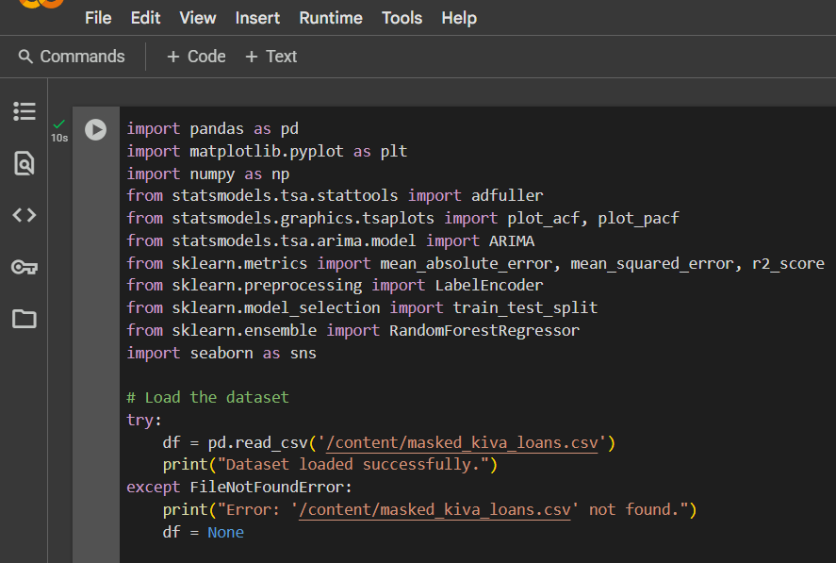
2.Data discovery and statistics
First, we import all required
then ,we read the csv file in the data frame called data

Slide 5
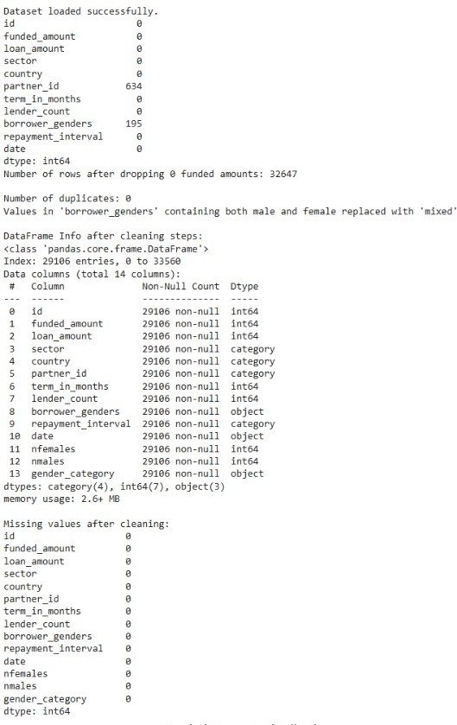
2.Data discovery and statistics
we see if there is a null value in any column or not
Handle missing values
Drop rows where 'funded_amount' is 0
Check for duplicates

Slide 6
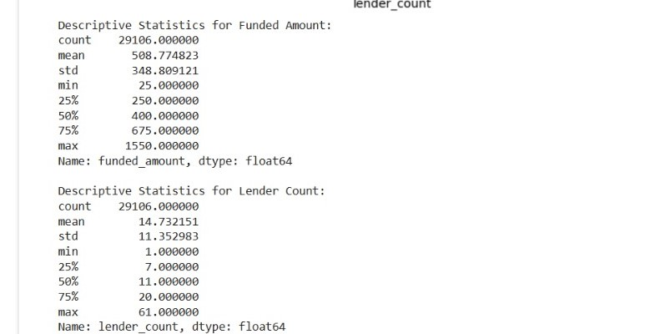
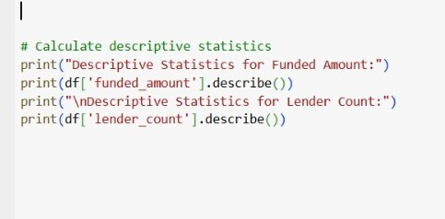
2.Data Discovery and statistics

Slide 7
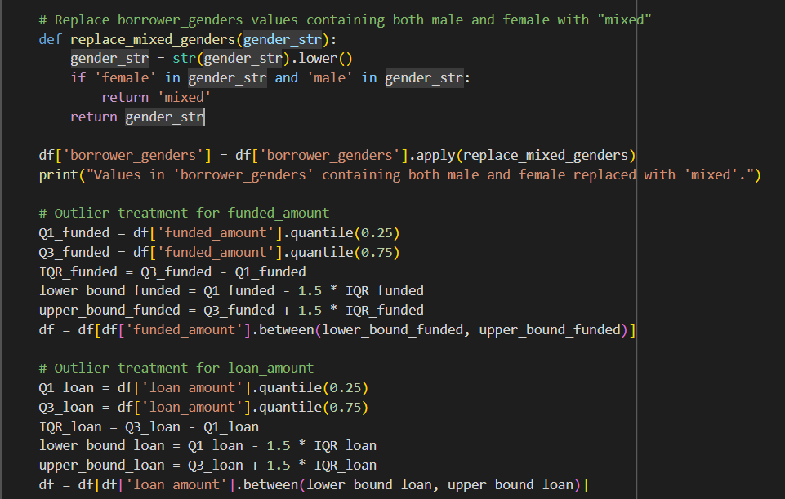
3. Data preprocessing
Replace borrower_genders values
containing both male and female
with "mixed“
Remove outliers for funded amount
Remove outliers for loan amount

Slide 8
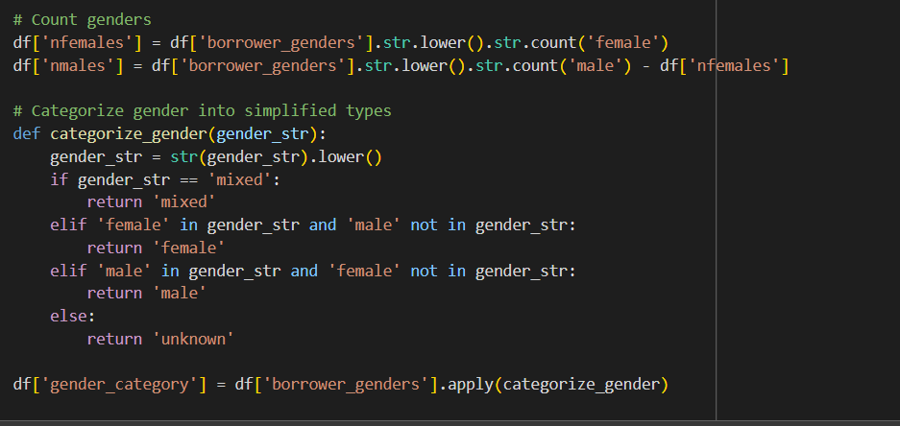
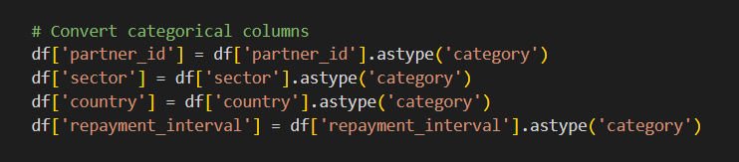
3. Data preprocessing
Count genders
Categorize gender into simplified types
Convert categorical
columns to use it in
Machine learning
Models if needed

Slide 9
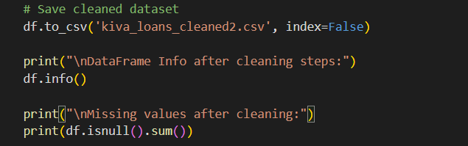
3. Data preprocessing
Finally save the cleaned dataset and chceck for
Cleaning steps

Slide 10
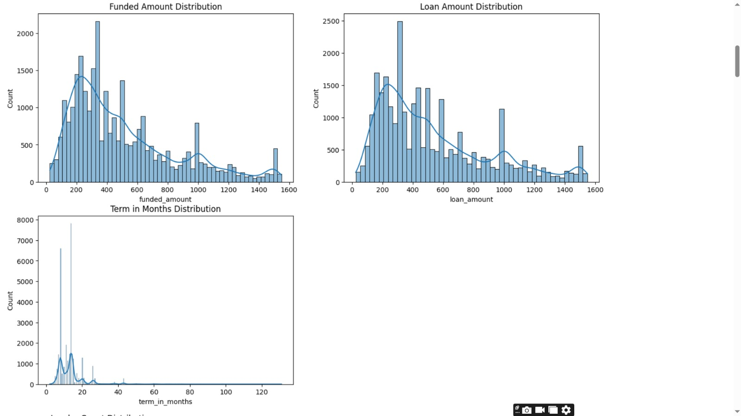
4.Data visualization
Histograms for numerical features
1.funded amount
2.loan amount
3.term in mounths

Slide 11
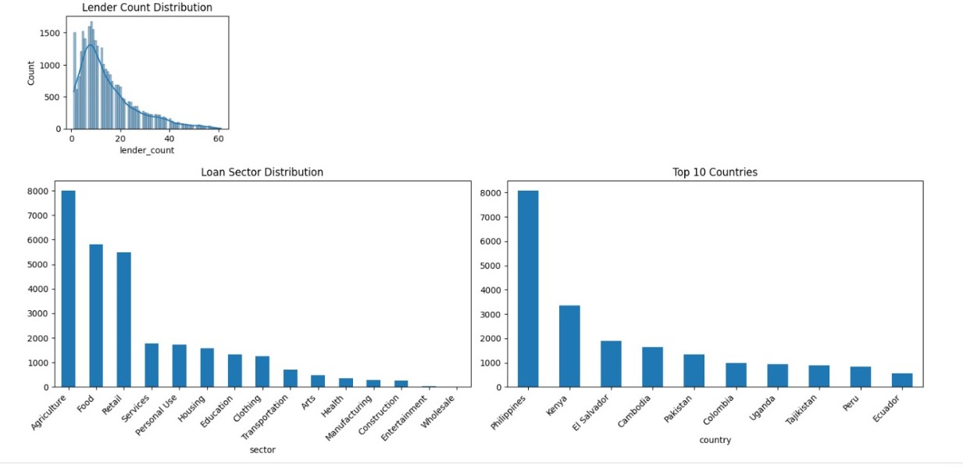
4.Data visualization
Lender count distribution using histogram.
Loan sector barchart.
Top ten countries with most loans
Barchart.

Slide 12
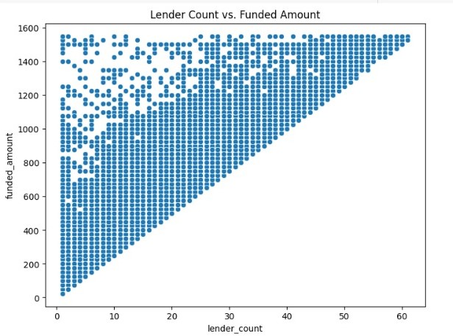
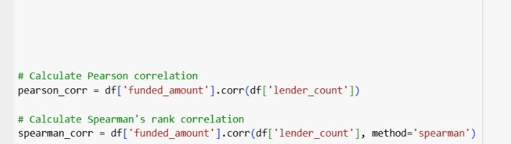
4.Data visualization.
answering if there is a correlation between the number of lenders and the funded loan amount using scatter plot
Pearson correlation coefficient: 0.8651818798963389S
pearman 's rank correlation coefficient: 0.8418241050887878

Slide 13
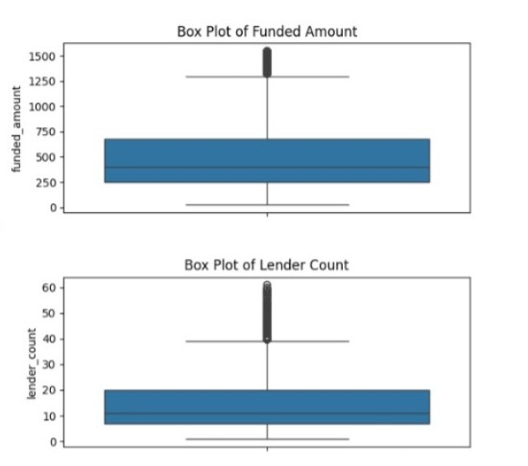
4.Data visualization.
Box plots for funded amount
and lender count

Slide 14
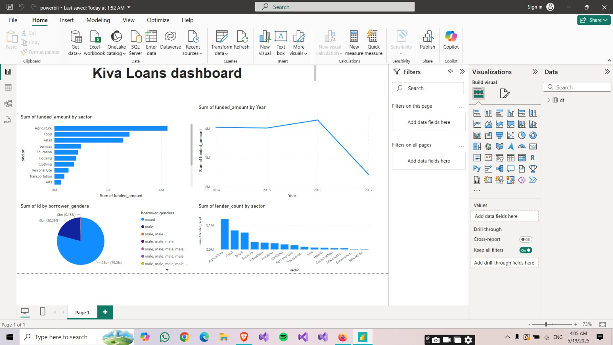
4.Data visualization.
Using power bi for answering Which sectors receive the highest amount of funding, and how does this change over time?

Slide 15
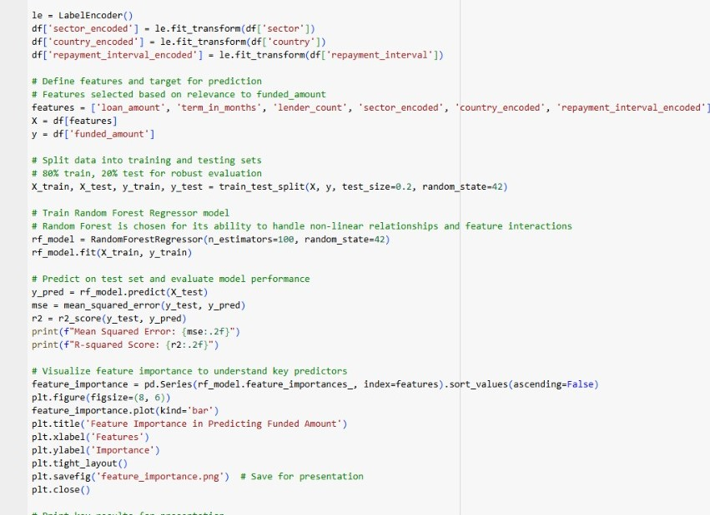
5.Machine learning model.
# Define features and target for prediction# Features selected based on relevance to funded_amount.
# Split data into training and testing sets# 80% train, 20% test for robust evaluation.
# Train Random Forest Regressor model# Random Forest is chosen for its ability to handle non-linear relationships and feature interactions.
Key Results for Presentation:1. Model Performance: R-squared = 0.95, MSE = 5933.812. Top Feature: loan_amount with importance 0.8963. Feature importance plot saved as 'feature_importance.png’.

Slide 16
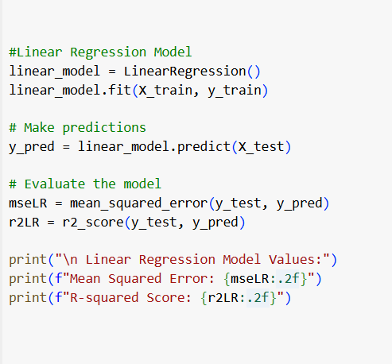
5.Machine learning model.
# Define features and target for prediction# Features selected based on relevance to funded_amount.
# Split data into training and testing sets
# 80% train, 20% test for robust evaluation.
# Train Linear regression models.
Linear Regression Model Values:
Mean Squared Error: 9644.62
R-squared Score: 0.92
.

Slide 17
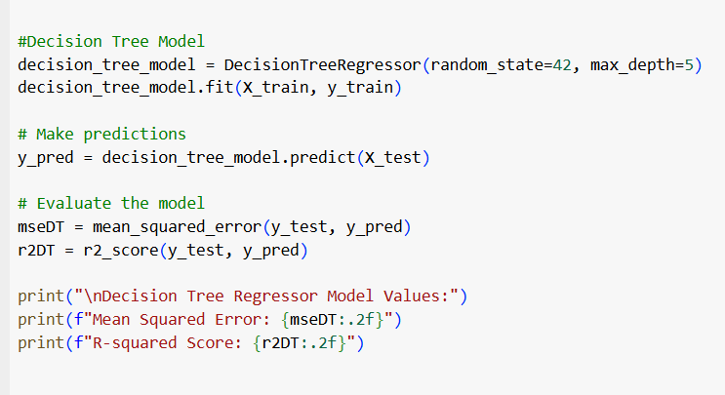
5.Machine learning model.
# Define features and target for prediction# Features selected based on relevance to funded_amount.
# Split data into training and testing sets# 80% train, 20% test for robust evaluation.
# Train Decision tree model ll
Key Results for Presentation:1. Model Performance: R-squared = 0.95, MSE = 6588.07. .

Slide 18
5.Machine learning model.
# Define features and target for prediction# Features selected based on relevance to funded_amount.
# Split data into training and testing sets# 80% train, 20% test for robust evaluation.
# Train Random Forest Regressor model# Random Forest is chosen for its ability to handle non-linear relationships and feature interactions.
Key Results for Presentation:1. Model Performance: R-squared = 0.95, MSE = 5933.812. Top Feature: loan_amount with importance 0.8963. Feature importance plot saved as 'feature_importance.png’.

Slide 19
5.Machine learning model.
# Define features and target for prediction# Features selected based on relevance to funded_amount.
# Split data into training and testing sets# 80% train, 20% test for robust evaluation.
# Train Random Forest Regressor model# Random Forest is chosen for its ability to handle non-linear relationships and feature interactions.
Key Results for Presentation:1. Model Performance: R-squared = 0.95, MSE = 5933.812. Top Feature: loan_amount with importance 0.8963. Feature importance plot saved as 'feature_importance.png’.

Slide 20
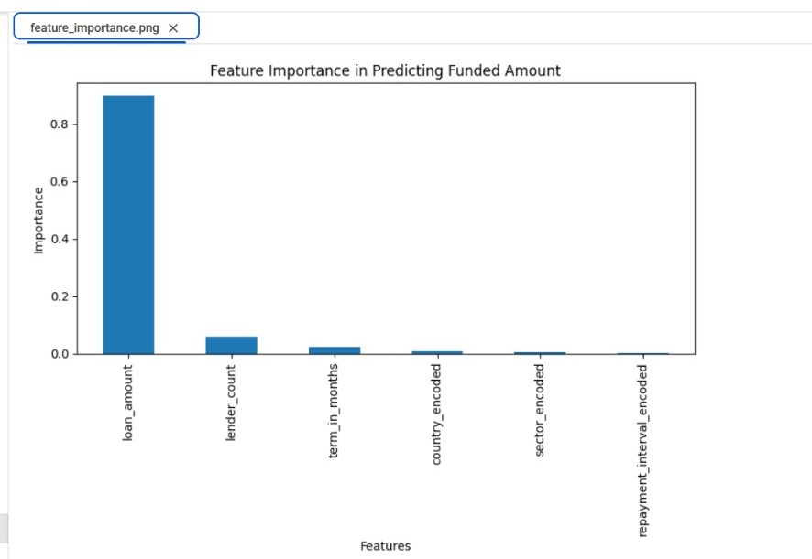
5.Machine learning model.
Visualize feature importance to understand key predictors

Slide 21
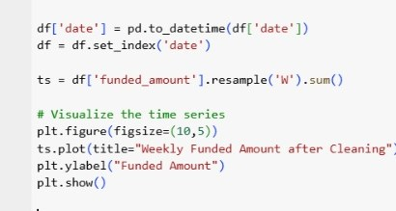
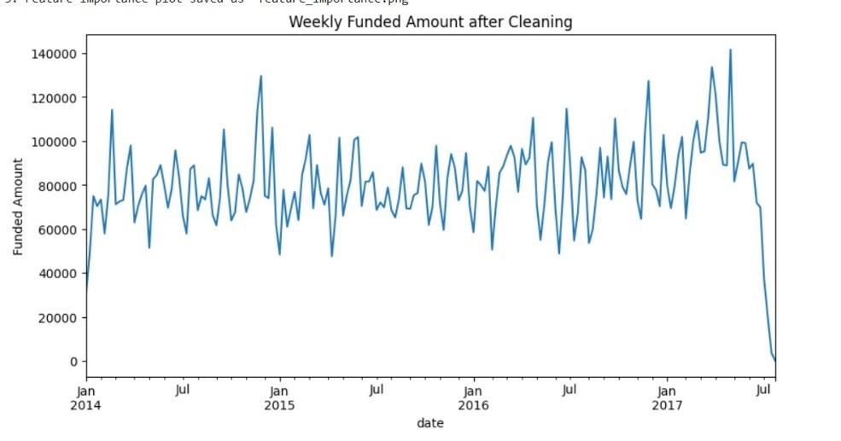
6.Time series.
Setting date as key dimension.
Visualizing time series

Slide 22
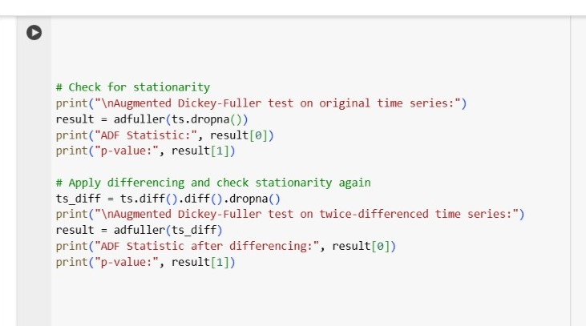
6.Time series.
applying dickey fuller to find correct differencing with p_value <0.05
Augmented Dickey-Fuller test on original time series:ADF Statistic: -3.7975625900895187
p-value: 0.0029323515638552404
Augmented Dickey-Fuller test on twice-differenced time series:
ADF Statistic after differencing:
-5.429504281126562
p-value: 2.93595258066366e-06

Slide 23
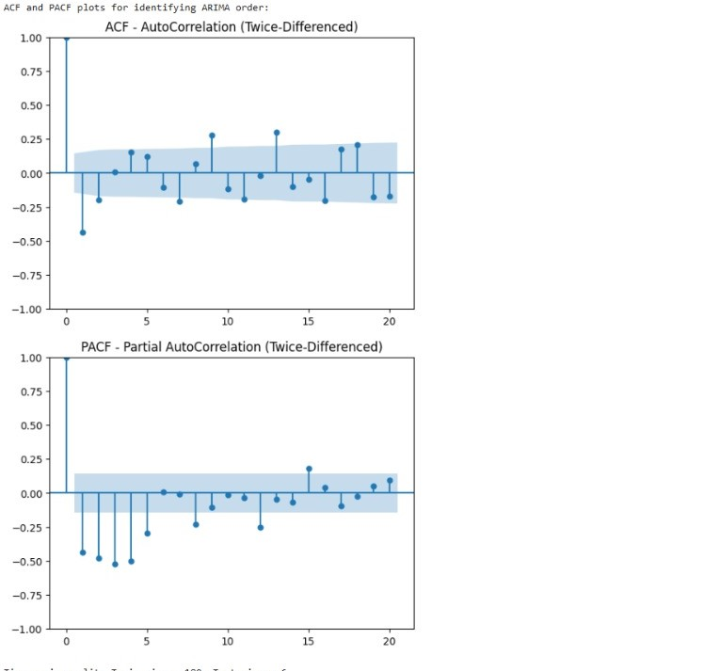
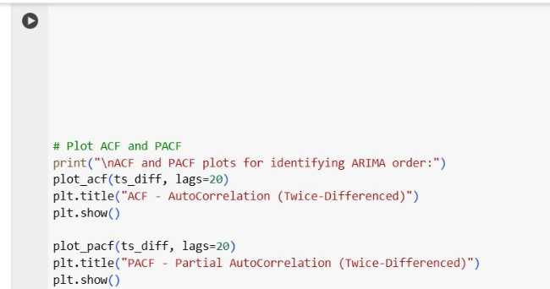
6.Time series.

Slide 24
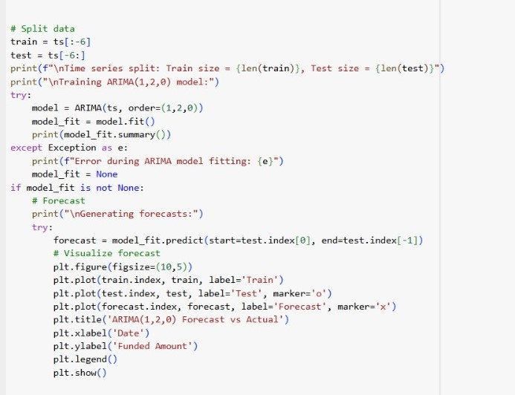
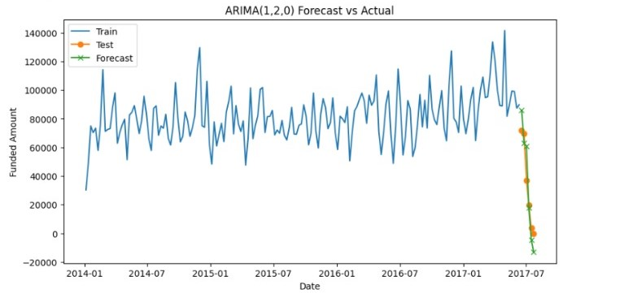
6.Time series.
splitting data and training arima model using correct p,d,q.
forecasting future.

Slide 25
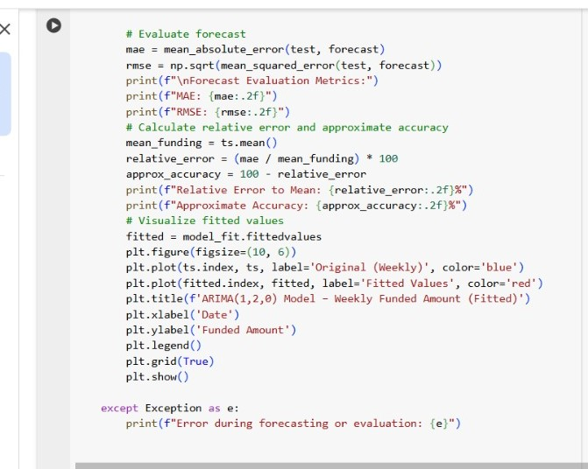
6.Time series.
# Evaluate forecast
# Calculate relative error and approximate accuracy

Slide 26
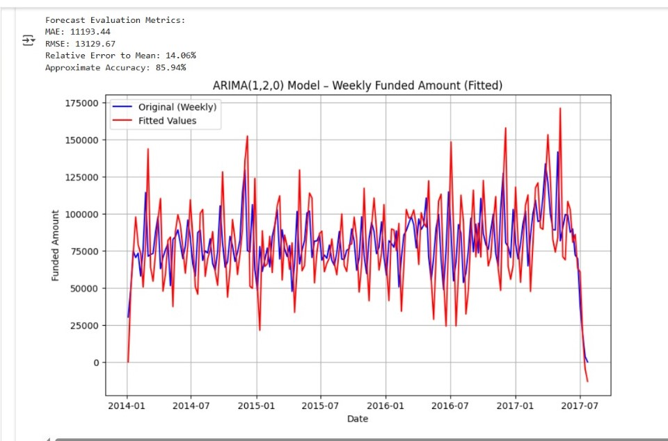
6.Time series.
# Evaluate forecast
# Calculate relative error and approximate accuracy.
# Visualize fitted values.

Slide 27
7..Conclusion
Comprehensive Analysis of Kiva Loans Dataset : Cleaned data: handled missing values, outliers, standardized genders.Revealed skewed distributions, key sectors (e.g., Agriculture), top countries (e.g., Philippines).Key Insights from EDA:Strong lender count vs. funded amount correlation (Spearman preferred).Visualizations showed gender, sector, regional trends.Robust Predictive Modeling:Running three different machine learning models Random Forest led with high R², low MSE; key predictors: loan amount, lender count.Effective Time Series Forecasting:ARIMA(1,2,0) forecasted weekly funding with good accuracy (MAE, RMSE).Stationarity achieved via differencing, confirmed by ADF tests.Outcomes and Impact:Saved cleaned data, visualizations for future use.Actionable insights for microfinance optimization.Future Improvements : Tune ARIMA, explore seasonal models.Add features (e.g., economic indicators) for better predictions.

